Slide 1
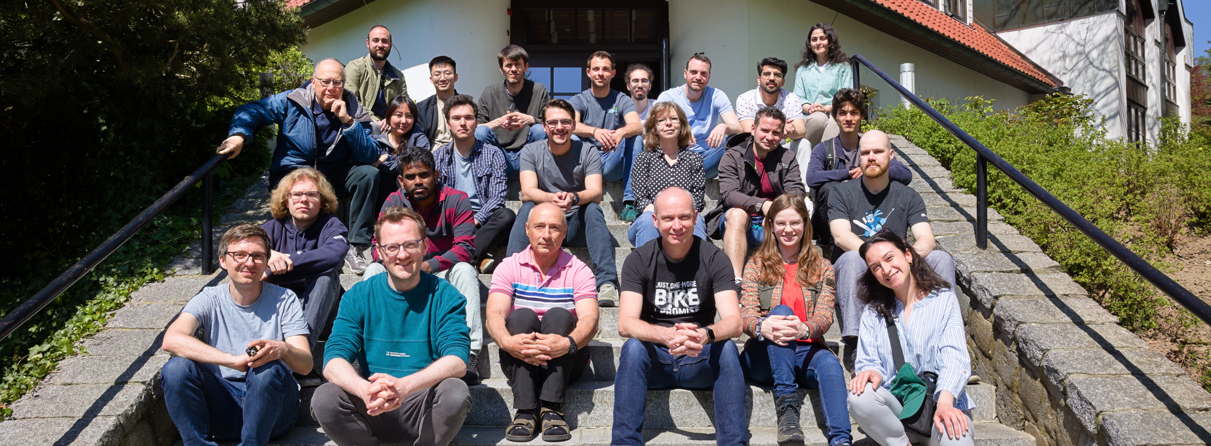
Tiny CNN with microfluidic pipes
Jorge Torres Gómez | Telecommunication Networks

Slide 2
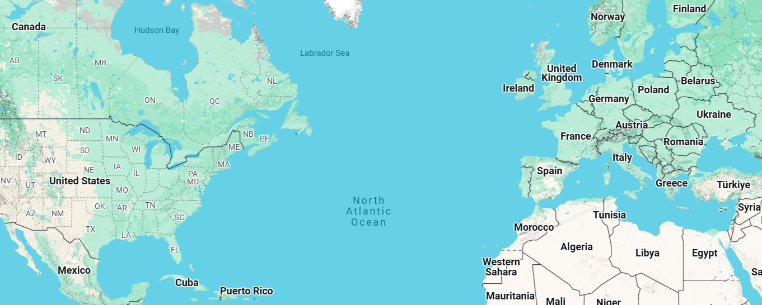

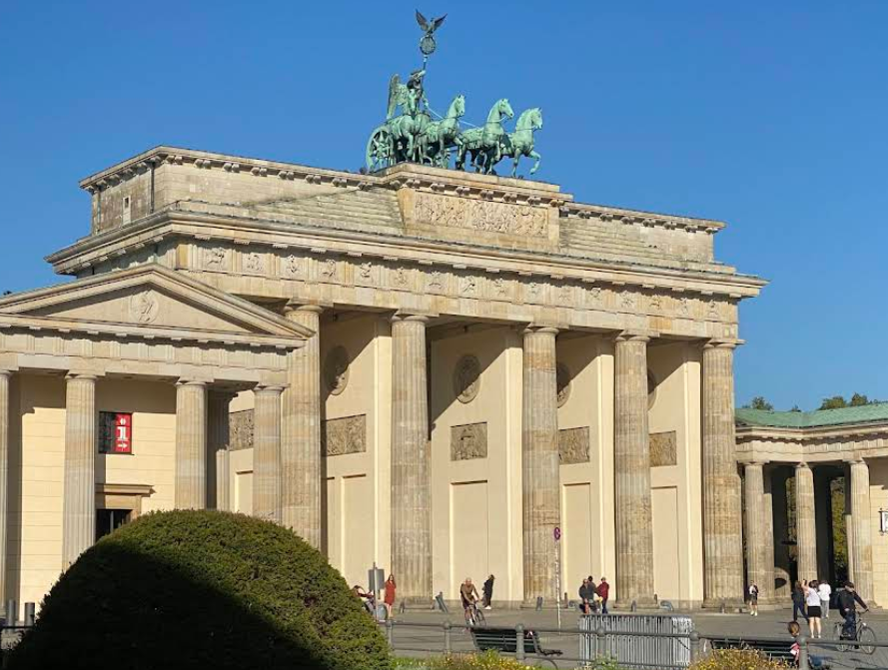




Slide 3
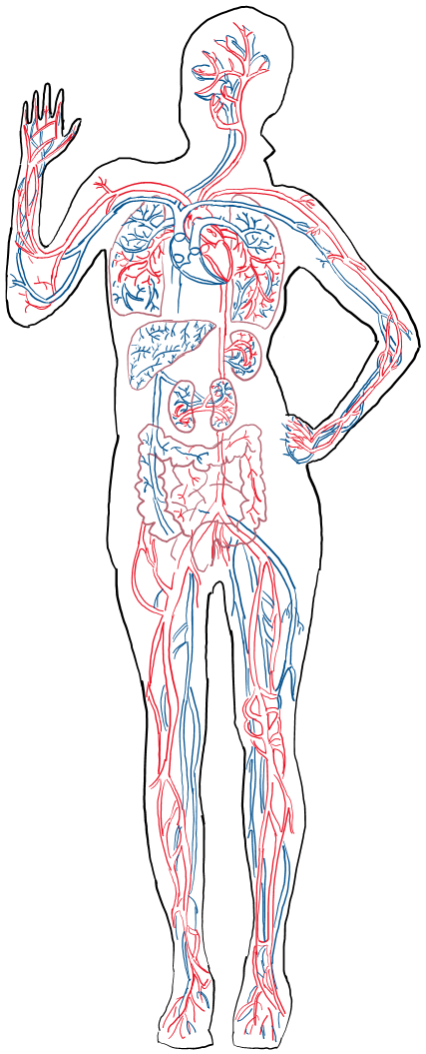





Internet of Bio-Nano-Things
Gateway
Remote
Monitor
nanosensor
Wound

Slide 4
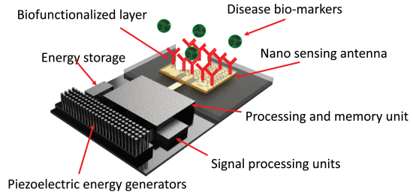
Internet of Bio-Nano-Things
Gateway
Remote
Monitor
nanosensor
Wound
[1] A. Sangwan and J. M. Jornet, "Joint Communication and Bio-Sensing With Plasmonic Nano-Systems to Prevent the Spread of Infectious Diseases in the Internet of Nano-Bio Things," in IEEE Journal on Selected Areas in Communications, vol. 40, no. 11, pp. 3271-3284, Nov. 2022, doi: 10.1109/JSAC.2022.3214288.

Slide 5
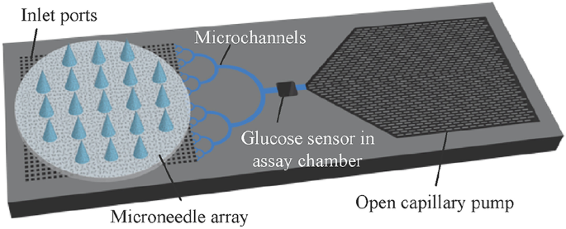

Gateway
Gateway
nanosensor
[1] Takeuchi, K., Takama, N., Sharma, K. et al. Microfluidic chip connected to porous microneedle array for continuous ISF sampling. Drug Deliv. and Transl. Res. 12, 435–443 (2022).

Slide 6
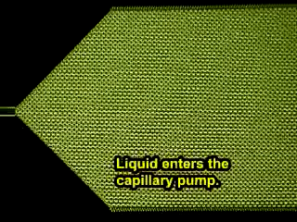
[1] Takeuchi, K., Takama, N., Sharma, K. et al. Microfluidic chip connected to porous microneedle array for continuous ISF sampling. Drug Deliv. and Transl. Res. 12, 435–443 (2022).

Slide 7
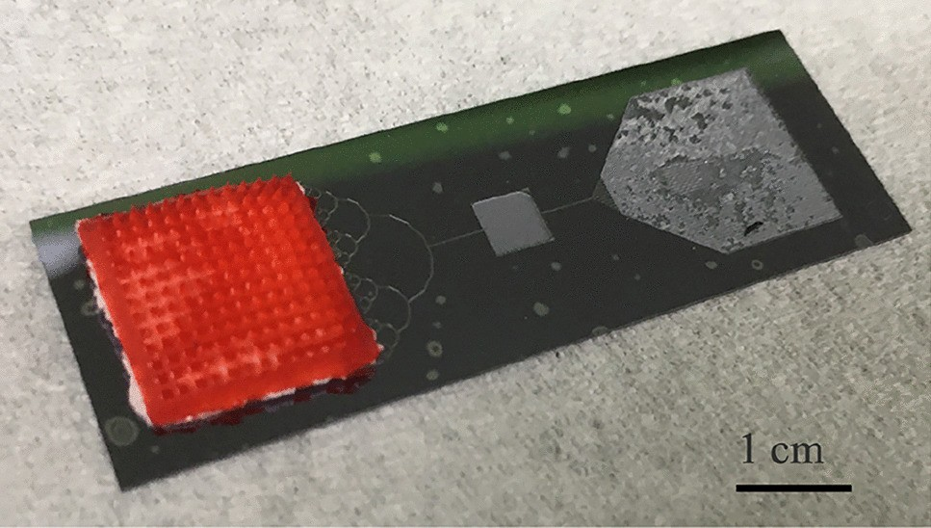
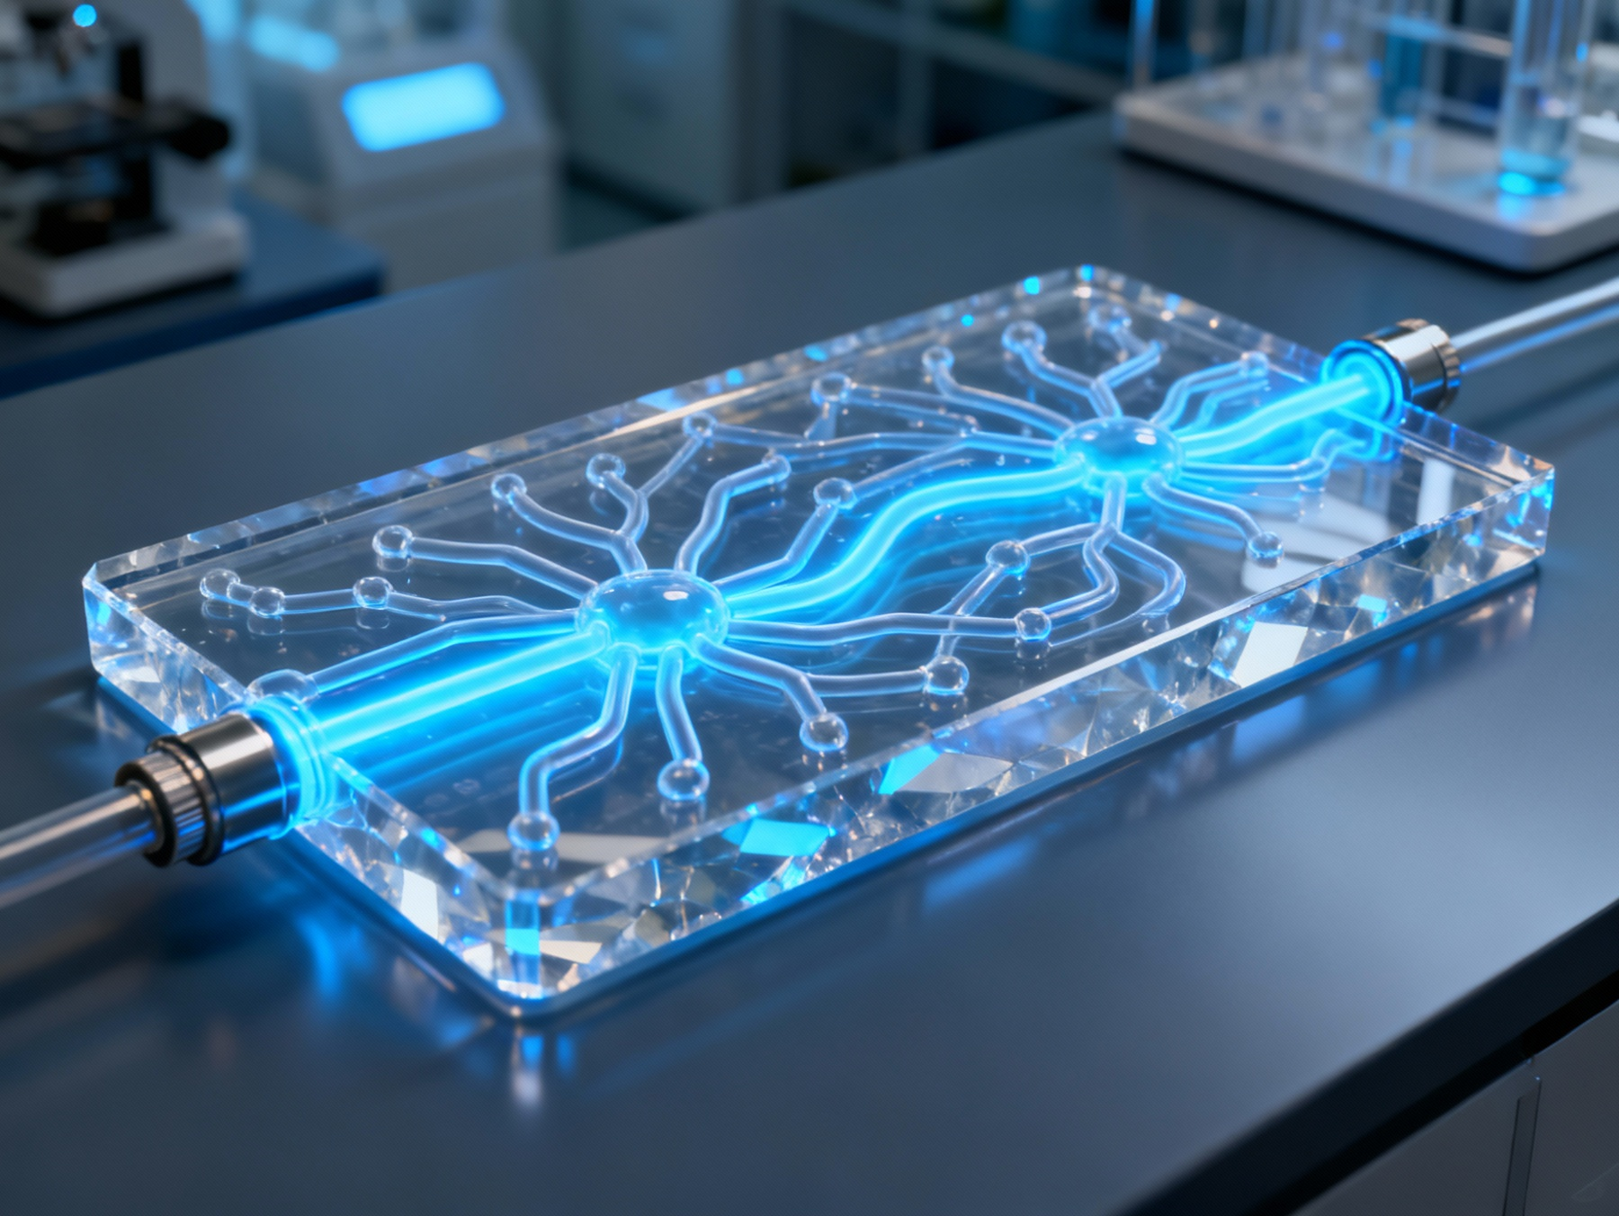
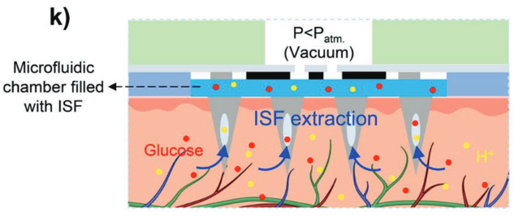
Pump
Microneedles
Neural Network System
[1] Takeuchi, K., Takama, N., Sharma, K. et al. Microfluidic chip connected to porous microneedle array for continuous ISF sampling. Drug Deliv. and Transl. Res. 12, 435–443 (2022).
[2] T. Abbasiasl et al., “A Wearable Touch-Activated Device Integrated with Hollow Microneedles for Continuous Sampling and Sensing of Dermal Interstitial Fluid,” Advanced Materials, vol. 36, no. 2, p. 2304704, 2024, doi: 10.1002/adma.202304704.

Slide 8
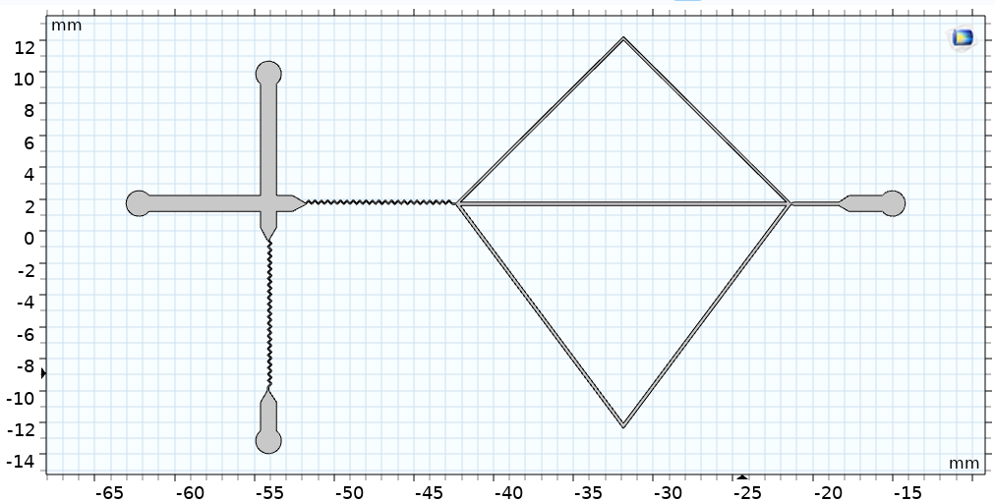
Pump
Microneedles
CNN System
Pipe 2
Pipe 1
Pipe 3
[1] Takeuchi, K., Takama, N., Sharma, K. et al. Microfluidic chip connected to porous microneedle array for continuous ISF sampling. Drug Deliv. and Transl. Res. 12, 435–443 (2022).

Slide 9
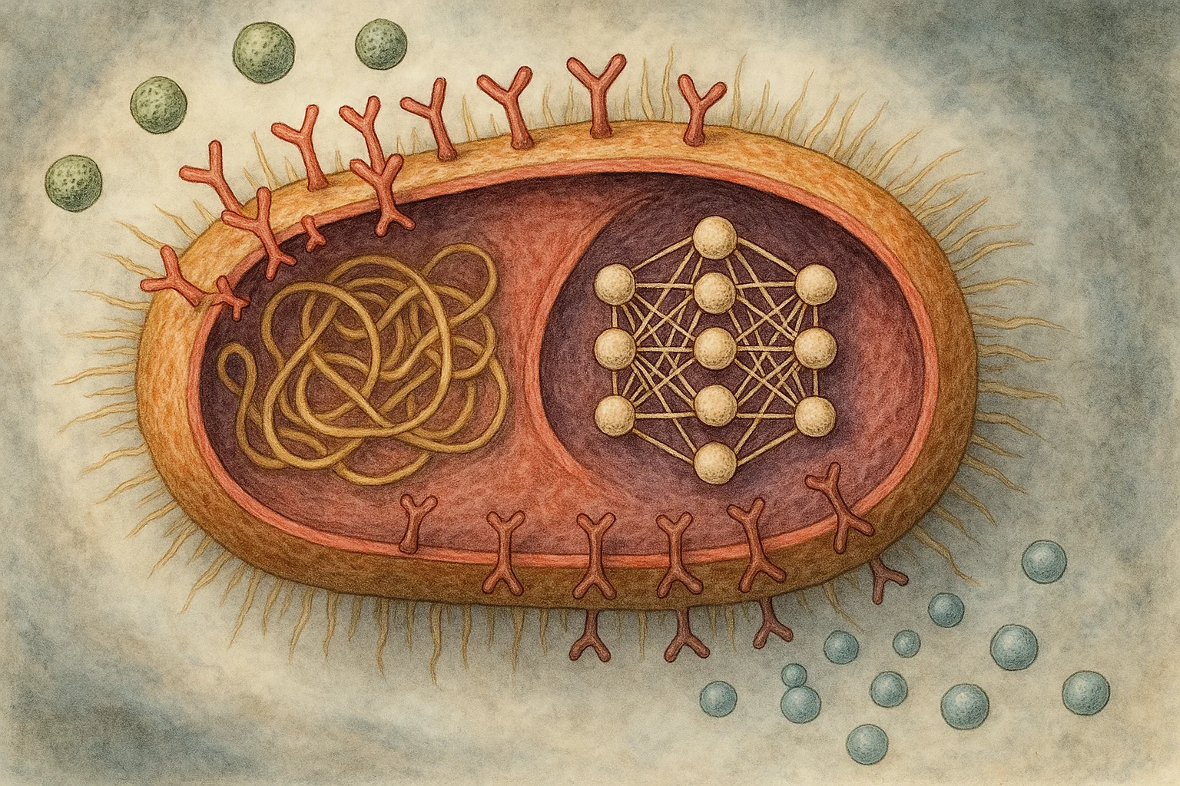
Research Questions
What biological constraints limit the feasibility of running NNs in living cells?
Which NN architectures can realistically be supported under these biological constraints?
How can we implement online training algorithms that adapt to biological environments in real-time?
Notes:
Already smart mechanism within the cell.
Hosting a NN within a cell (prokaryote or eukaryote)?
Complexity level achievable within the cell?
Online training NNs within the cell? (evolutionary concepts)
What are the biological constraints (space and energy)?
Online learning?

Slide 10
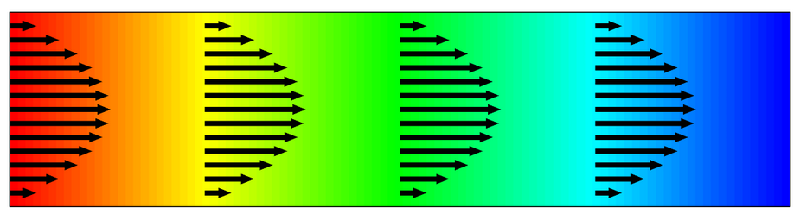

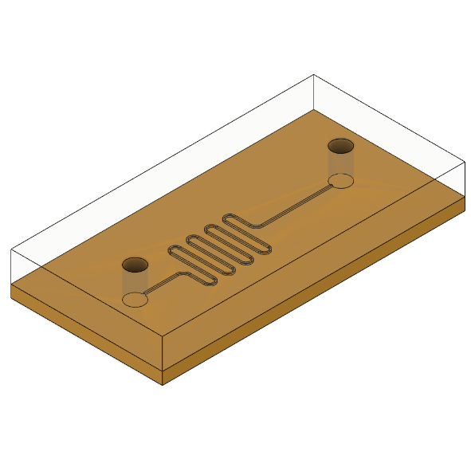
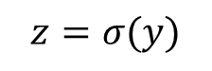
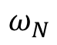
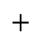
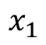

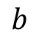
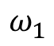
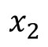
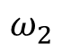
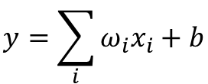
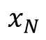
Bio-Computing
Single Neuron Scheme
$$b$$
Activation
Function
$$x_{1}$$
$$ω_{N}$$
$$y=\sum_{i}{ω_{i}x_{i}}+b$$
$$x_{2}$$
$$ω_{2}$$
$$+$$
$$z=σ(y)$$
$$⋯$$
$$x_{N}$$
$$ω_{1}$$
Transport of Diluted Species
Chemical
Reaction
[1] A. O. Bicen and I. F. Akyildiz, “System-Theoretic Analysis and Least-Squares Design of Microfluidic Channels for Flow-Induced Molecular Communication,” IEEE Transactions on Signal Processing, vol. 61, no. 20, pp. 5000–5013, Oct. 2013, doi: 10.1109/TSP.2013.2274959.
Microfluidic Circuit
10

Slide 11
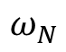
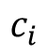
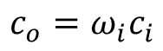
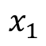
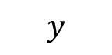
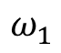
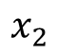
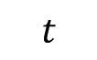
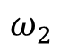
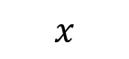
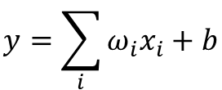
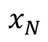
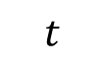
Concept
Single Neuron Scheme
$$b$$
Activation
Function
$$x_{1}$$
$$ω_{N}$$
$$y=\sum_{i}{ω_{i}x_{i}}+b$$
$$x_{2}$$
$$ω_{2}$$
$$+$$
$$z=σ(y)$$
$$⋯$$
$$x_{N}$$
$$ω_{1}$$
$$y$$
Transport of Diluted Species
Inlet
Outlet
$$x$$
$$c_{i}$$
$$c_{o}=ω_{i}c_{i}$$
$$t$$
$$t$$
11

Slide 12
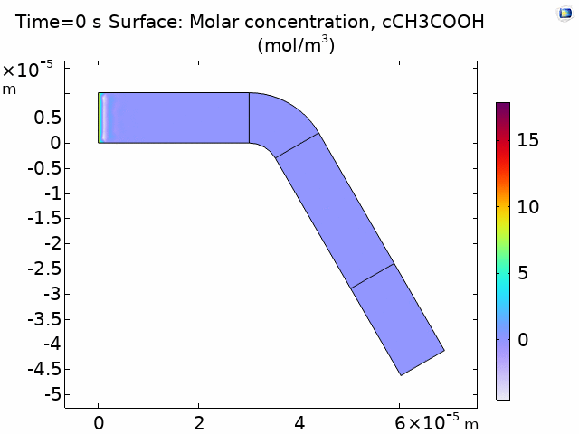

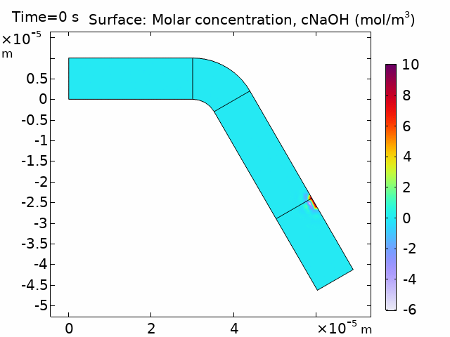

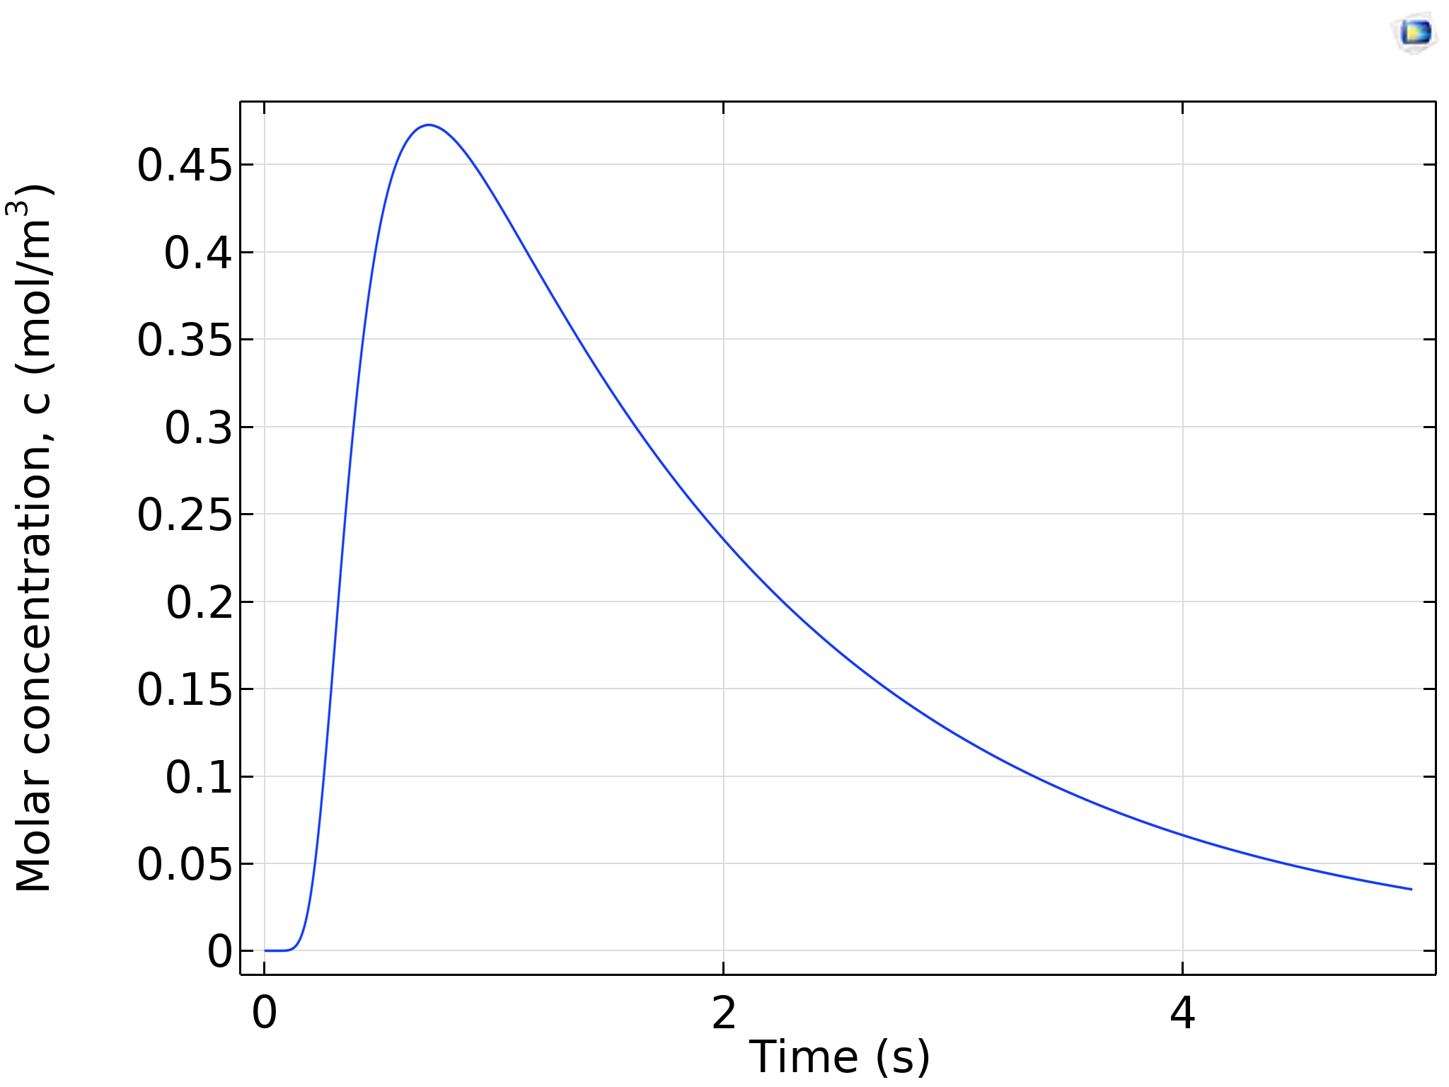
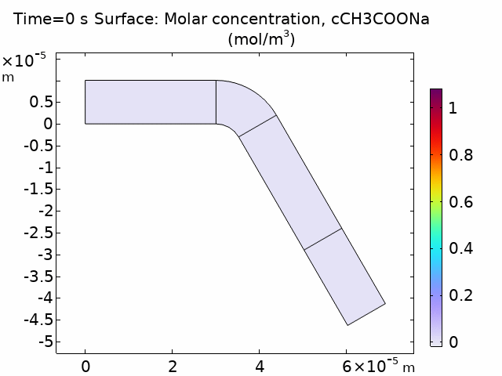
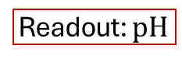
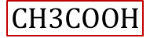
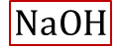
Concept
Activation
Function
$$NaOH$$
$$CH3COOH$$
$$NaOH+CH3COOH →CH3COONa+H2O$$
Readout: $pH$
12

Slide 13

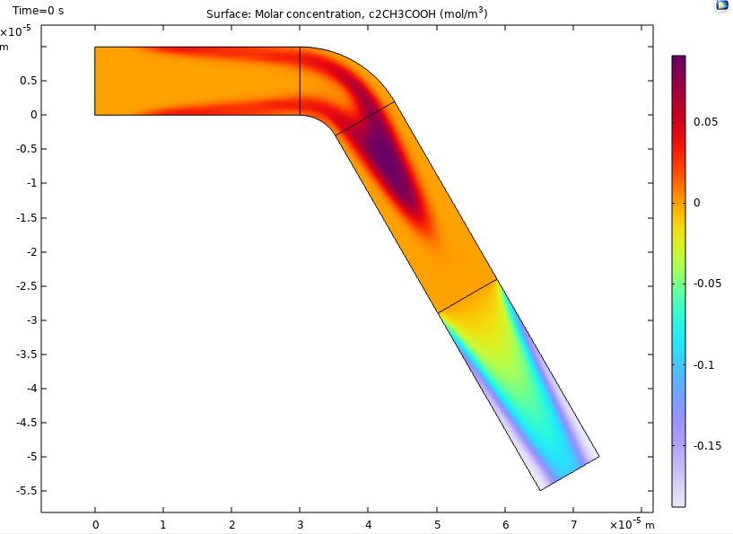
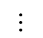
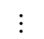
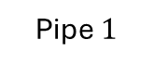
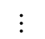
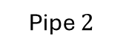




Concept
Single Neuron Scheme
Pipe $N$
$$⋯$$
Pipe $2$
Inlets
Inlet B
Pipe $1$
Outlet
Chemical Reactor
Combiner
CNN-like Scheme
Pipe $N$
$$⋯$$
$$⋯$$
Inlet B
Pipe $2$
Inlet A
Outlet
Pipe $1$
Chemical Reactor
Splitter
Combiner
13

Slide 14







Concept
COMSOL Simulations
CNN-like Scheme
Pipe $N$
$$⋯$$
$$⋯$$
Inlet B
Pipe $2$
Inlet A
Outlet
Pipe $1$
Chemical Reactor
Splitter
Combiner
Parameter | Value
$h$ | $38 μm$
$Q$ | $2$ $μL/min$
$D$ Tartrazine | $4.9∙{10}^{−10} [m^{2}/s]$
$∆P$ | $4.416$ mbar
14

Slide 15

Concept
COMSOL Simulations
CNN-like Scheme
Pipe $N$
$$⋯$$
$$⋯$$
Inlet B
Pipe $2$
Inlet A
Outlet
Pipe $1$
Chemical Reactor
Splitter
Combiner
15

Slide 16



















Synthesis
CNN-like Scheme
Pipe $2$
$$Q_{2}$$
Pipe $1$
Define the sampling time on Pipe 1
$$∆P$$
$$Q_{1}$$
$$L_{1}$$
$$w_{1}$$
Outlet
$$c\left(L,t\right)=\frac{1}{2}C_{0}\text{erfc}\frac{L_{1}−v_{\text{char}}t}{2\sqrt{D_{\text{eff}} t}}$$
$$\sqrt{48}≪\text{Pe}≪4\frac{L}{r}$$
$$Q_{3}$$
Pipe $3$
$$h(t)=\frac{∂}{∂t}c\left(L,t\right){\left.​\right|}_{C_{0}=1}$$
Parameter | Value
$h$ | $38 μm$
$∆P$ | $600$ Pa
$D$ Tartrazine | $4.9∙{10}^{−10} [m^{2}/s]$
$$v_{\text{char}}=\overline{v}=\frac{Q_{1}}{w_{1}h}$$
$$Q_{1}=\frac{∆P }{R_{1}}$$
$$R_{1}=\frac{12μL_{1}}{1−0.63h/w_{1}}\frac{1}{h^{3}w_{1}}$$
$$\text{Pe}=\frac{h^{2}v_{\text{char}}}{D}$$
$$D_{\text{eff}}=D\left(1+1/200 {\text{Pe}}^{2}\right)$$
16

Slide 17









Synthesis
Parameter | Value
$h$ | $50 μm$
$∆P$ | $600$ Pa
$D$ Tartrazine | $4.9∙{10}^{−10} [m^{2}/s]$
CNN-like Scheme
Pipe $2$
$$Q_{2}$$
Pipe $1$
Define the sampling time on Pipe 1
$$∆P$$
$$Q_{1}$$
$$L_{1}$$
$$w_{1}$$
Outlet
$$c\left(L,t\right)=\frac{1}{2}C_{0}\text{erfc}\frac{L_{1}−v_{\text{char}}t}{2\sqrt{D_{\text{eff}} t}}$$
$$\sqrt{48}≪\text{Pe}≪4\frac{L}{r}$$
(1)
$$Q_{3}$$
Pipe $3$
$$h(t)=\frac{∂}{∂t}c\left(L_{1},t\right){\left.​\right|}_{C_{0}=1}$$
(2)
$$v_{\text{char}}=\overline{v}=\frac{Q_{1}}{w_{1}h}$$
(3)
$$Q_{1}=\frac{∆P }{R_{1}}$$
(4)
$$R_{1}=\frac{12μL_{1}}{1−0.63h/w_{1}}\frac{1}{h^{3}w_{1}}$$
(5)
$$\text{Pe}=\frac{h^{2}v_{\text{char}}}{D}$$
(6)
17
$$D_{\text{eff}}=D\left(1+1/200 {\text{Pe}}^{2}\right)$$
(7)

Slide 18












Synthesis
CNN-like Scheme
Pipe $2$
Define the sampling time on Pipe 1
$$Q_{2}$$
Pipe $1$
$$∆P$$
$$Q_{1}$$
$$L_{1}$$
$$w_{1}$$
Outlet
$$c\left(L,t\right)=\frac{1}{2}C_{0}\text{erfc}\frac{L_{1}−v_{\text{char}}t}{2\sqrt{D_{\text{eff}} t}}$$
$$\sqrt{48}≪\text{Pe}≪4\frac{L}{r}$$
(1)
$$Q_{3}$$
Pipe $3$
$$h(t)=\frac{∂}{∂t}c\left(L_{1},t\right){\left.​\right|}_{C_{0}=1}$$
(2)
Parameter | Value
$h$ | $38 μm$
$Q$ | $2$ $μL/min$
$D$ Tartrazine | $4.9∙{10}^{−10} [m^{2}/s]$
$∆P$ | $4.416$ mbar
$$τ=\frac{L_{1}}{v_{\text{char}}}−\frac{2D_{\text{eff}}}{v_{\text{char}}}$$
(3)
Pipe $3$
$$v_{\text{char}}=\overline{v}=\frac{Q_{1}}{w_{1}h}$$
(4)
Pipe $2$
$$Q_{1}=\frac{∆P }{R_{1}}$$
$$R_{1}=\frac{12μL_{1}}{1−0.63h/w_{1}}\frac{1}{h^{3}w_{1}}$$
(5)
(6)
Pipe $1$
$$\text{Pe}=\frac{h^{2}v_{\text{char}}}{D}$$
(7)
$$D_{\text{eff}}=D\left(1+1/200 {\text{Pe}}^{2}\right)$$
(8)
18

Slide 19

















Synthesis
Parameter | Value
$h$ | $38 μm$
$∆P$ | $600$ Pa
$D$ Tartrazine | $4.9∙{10}^{−10} [m^{2}/s]$
CNN-like Scheme
Pipe $2$
Phase 1
2. Evaluate the design in COMSOL
$$Q_{2}$$
Pipe $1$
$$∆P$$
$$Q_{1}$$
$$L_{1}$$
$$w_{1}$$
Outlet
$$τ=\frac{L}{v_{\text{char}}}−\frac{2D_{\text{eff}}}{v_{\text{char}}}$$
$$Q_{3}$$
(1)
Pipe $3$
19

Slide 20


Synthesis
CNN-like Scheme
Pipe $2$
$$Q_{2}$$
Pipe $1$
Phase 2
3. Find the correction
4. Re-design in COMSOL
$$∆P$$
$$Q_{1}$$
$$L_{1}$$
$$w_{1}$$
Outlet
$$Q_{3}$$
Pipe $3$
$$∆τ→∆L$$
$$∆τ=\frac{∆L}{v_{\text{char}}}−\frac{2D_{\text{eff}}}{v_{\text{char}}}$$
(1)
20

Slide 21



Synthesis
CNN-like Scheme
Parameter | Value
$h$ | $38 μm$
$∆P$ | $600$ Pa
$D$ Tartrazine | $4.9∙{10}^{−10} [m^{2}/s]$
Pipe $2$
$$Q_{2}$$
Pipe $1$
3. Find the correction
4. Re-design in COMSOL
$$∆P$$
$$Q_{1}$$
$$L_{1}$$
$$w_{1}$$
Outlet
$$Q_{3}$$
Pipe $3$
21

Slide 22
Experiment 1: Design 1.1
Design 1.1
Pipe 2
Pipe 1
Purpose
Validate the synchronization of pulses through the three different pipes.
Architecture
Transmitter + CNN
Dimensions
Total size: 4.8 x 2.9 cm
Chemicals
Tartrazine and H2O
Study phase
Theoretical calculations completed
Simulation in COMSOL completed
Experimental validation is missing
Pipe 3

Slide 23





Experiment Design
Experiment 3
NaOH, CH₃COOH
Experiments 1 & 2
(Tartrazine)
CNN-like Scheme
Pipe $3$
Transmitter
500 μm to 1 mm
Inlet B
$$⋯$$
Pipe $2$
Communication Channel
Inlet C
Inlet A
Outlet B
Pipe $1$
Outlet A
Experiment 4
NaOH, CH₃COOH

Slide 24

Experiment 1: Design 1.1
Purpose
Validate the synchronization of pulses through the three different pipes.
Architecture
Transmitter + CNN
Dimensions
Total size: 4.8 x 2.6 cm
Chemicals
Tartrazine and H2O
Study phase
Theoretical calculations
Simulation in COMSOL
Experimental-

Slide 25




Experiment 1: Design 1.1
Parameter | Value
$h$ | $38 μm$
$T_{p}$ | $500$ ms
$D$ Tartrazine | $4.9∙{10}^{−10} [m^{2}/s]$
$Q$ | $2.2 [uL/min]$
Notes:
Experiment conducted on 7 Oct. 2025, flow rate Q=6uL/min

Slide 26






Experiment 1: Design 1.1
Pipe $2$
Parameter | Value
$h$ | $38 μm$
$T_{p}$ | $500$ ms
$D$ Tartrazine | $4.9∙{10}^{−10} [m^{2}/s]$
$Q$ | $2.6 [uL/min]$
Pipe $1$
Pipe $3$
Notes:
Experiment conducted on 7 Oct. 2025, flow rate Q=6uL/min

Slide 27




Experiment 1: Design 1.1
Pipe $3$
Parameter | Value
$h$ | $38 μm$
$T_{p}$ | $1$ s
$D$ Tartrazine | $4.9∙{10}^{−10} [m^{2}/s]$
$Q$ | $2.15 [uL/min]$
Notes:
Experiment conducted on 7 Oct. 2025, flow rate Q=6uL/min

Slide 28



Experiment 1: Design 1.1
Parameter | Value
$h$ | $38 μm$
$T_{p}$ | $1.5$ s
$D$ Tartrazine | $4.9∙{10}^{−10} [m^{2}/s]$
$Q$ | $2.2 [uL/min]$
Notes:
Experiment conducted on 7 Oct. 2025, flow rate Q=6uL/min

Slide 29




Design 1_2
Design 1_3
Design 1_4
Design 1_5
Notes:
Purpose:
Validate the shift of the peak at pipe 2 to the left.
Look for better mixing.

Slide 30






Notes:
Purpose:
Pulse length is 1.5s

Slide 31

Design 1_2
Pulse duration $1.5$s, $Q_{CNN}=5$ μL/min
Design 1_3
Design 1_4
Design 1_5
Notes:
Purpose:
Pulse length is 1.5s

Slide 32





Slide 33





Pulse duration $0.5$s, $Q_{CNN}=5$ μL/min
Design 1_3
Design 1_2
Design 1_5
Design 1_4
Notes:
Purpose:
Pulse length is 1.5s

Slide 34

Pulse duration $0.5$s, $Q_{CNN}=5$ μL/min
Notes:
Purpose:
Pulse length is 1.5s

Slide 35





Pulse duration $1$s, $Q_{CNN}=5$ μL/min
Design 1_3
Design 1_2
Design 1_5
Design 1_4
Notes:
Purpose:
Pulse length is 1.5s

Slide 36

Pulse duration $1$s, $Q_{CNN}=5$ μL/min
Notes:
Purpose:
Pulse length is 1.5s

Slide 37





Pulse duration $1.5$s, $Q_{CNN}=5$ μL/min
Design 1_3
Design 1_2
Design 1_5
Design 1_4
Notes:
Purpose:
Pulse length is 1.5s

Slide 38

Pulse duration $1.5$s, $Q_{CNN}=5$ μL/min
Notes:
Purpose:
Pulse length is 1.5s

Slide 39


Experiment 1: Design 1.2

Slide 40
Experiment 1: Design 1.2

Slide 41

Experiment 1: Design 1.1 → 1.2
Design 1.1
Purpose
Validate the synchronization of pulses through the three different pipes.
Architecture
Transmitter + CNN
Dimensions
Total size: 4.8 x 2.6 cm
Chemicals
Tartrazine and H2O
Study phase
Theoretical calculations completed
Simulation in COMSOL completed
Experimental validation is missing
$$∆τ→∆L$$
Design 1.1
Design 1.2

Slide 42




Experiment 2: Design 2
Pipe $3$
Design 2
Inlet B
$$⋯$$
Pipe $2$
Purpose:
To validate the synchronization of pulses and expected amplitudes through the three different pipes.
Components:
Transmitter+CNN
Chemicals:
NaOH
CH₃COOH
Study phase
Missing the theoretical calculations of the size for the Outlet C
Missing simulation in COMSOL.
Pipe $1$
Inlet A
Outlet B
Outlet A
Inlet C
Outlet C

Slide 43


Experiment 2: Design 2
Pipe $3$
Design 2
Inlet B
$$⋯$$
Pipe $2$
Pipe $1$
Inlet A
Outlet B
Outlet A
Inlet C
Outlet C
Phase 1
Phase 2

Slide 44


Experiment 3: Design 3
Purpose:
Caracterize the sensor regarding ist sensitivity.
Components:
Transmitter + Sensor
Chemicals:
NaOH
CH₃COOH
H₂O
Study phase
Missing the theoretical calculations of the size for the Outlet C
Missing simulation in COMSOL.
$$NaOH+CH3COOH →CH3COONa+H2O$$
Notes:
pH = -log(Ka) + log[CH3COO-]/[CH3COOH]
Ka= 1.8×10–5

Slide 45

Experiment 4: Design 4
Purpose:
To validate the complete system.
Components:
Transmitter+CNN+Sensor
Chemicals:
NaOH
CH3COOH
H2O
Study phase
Missing the theoretical calculations of the size for the Outlet C
Missing simulation in COMSOL.

Slide 46





Design 2
Pipe $3$
Pipe $2$
Pipe $1$

Slide 47



Design 1_2
Pipe 2
Pipe 1
Pipe 3

Slide 48



Design 2
$$ε=0.1$$
Pipe $3$
Pipe $1$
Pipe $2$
Pipe $1$
Pipe $3$
Pipe $2$

Slide 49









Design 3
Pipe $3$
$$ω_{out}$$
Pipe $2$
Pipe $1$
Pipe $3$
Pipe $1$
Pipe $2$

Slide 50






Design 3
Pipe $3$
Pipe $2$
Pipe $1$
Pipe $3$
Pipe $1$
Pipe $2$

Slide 51


Experiment 2: Design 3
Design 3
Phase 1
Phase 2
Parameter | Value
$h$ | $36 μm$
$T_{p}$ | $5$ ms
$D$ Tartrazine | $4.9∙{10}^{−10} [m^{2}/s]$
$Q$ | $5 [uL/min]$

Slide 52










Design 3
Pipe $3$
Pipe $2$
Pipe $3$
$$ω_{out}$$
$$L_{out}$$
Pipe $1$
Pipe $1$
Pipe $2$

Slide 53






Sensor
CNN-like Scheme
Pipe $N$
$$NaOH+CH3COOH →CH3COONa+H2O$$
$$⋯$$
$$⋯$$
Inlet B
Pipe $2$
Inlet A
Outlet
Pipe $1$
Chemical Reactor
Splitter
Combiner
53

Slide 54



Sensor
Inlet C
Inlet D
Outlet B
54

Slide 55
Sensor
CNN-like Scheme
Pipe $N$
$$NaOH+CH3COOH →CH3COONa+H2O$$
$$⋯$$
$$⋯$$
Inlet B
Pipe $2$
Inlet A
Outlet
Pipe $1$
Chemical Reactor
Splitter
Combiner
55

Slide 56
Tiny CNN with microfluidic pipes
Jorge Torres Gómez | Telecommunication Networks

Slide 57
Experiment 1: Design 1.1
Design 1.1
Pipe 2
Pipe 1
Purpose
Validate the synchronization of pulses through the three different pipes.
Architecture
Transmitter + CNN
Dimensions
Total size: 4.8 x 2.9 cm
Chemicals
Tartrazine and H2O
Study phase
Theoretical calculations completed
Simulation in COMSOL completed
Experimental validation is missing
Pipe 3

Slide 58




glucose
concentration
Single Neuron Scheme
Pipe $N$
$$⋯$$
Pipe $2$
Inlets
Inlet B
Pipe $1$
Outlet
Chemical Reactor
Combiner
time
serial-to-parallel
converter

Slide 59


























Analysis
$$y$$
$$y_{ro}$$
Derivative of the Step-response
$$c(x_{0},t)$$
$$r_{out}$$
$$c(x_{1},t)$$
$$r_{in}$$
$$c(x_{2},t)$$
$$x$$
(1)
$$l$$
$$φ$$
$$c_{r}(x_{ro},t)$$
(2)
O
$$x_{ro}$$
$${\overline{c}}_{r}(x_{ro},y_{ro},t)$$
(3)
$$y$$
$$c(x_{0},t)$$
$$c(x_{1},t)$$
$$c(x_{2},t)$$
$$l$$
(4)
(5)
$$x$$
(6)
59

Slide 60














Analysis
$$y$$
$$y_{ro}$$
$$r_{in}$$
$$r_{out}$$
$$c(x_{1},t)$$
$$c(x_{2},t)$$
$$c(x_{0},t)$$
$$x$$
$$l$$
Derivative of the Step-response
$$φ$$
$$c_{r}(x_{ro},t)$$
O
(1)
$$x_{ro}$$
$$x_{ro}$$
(2)
60

Slide 61








Analysis
$$y$$
$$y_{ro}$$
$$r_{in}$$
$$r_{out}$$
$$c(x_{1},t)$$
$$c(x_{2},t)$$
Derivative of the Step-response
$$x$$
$$c(x_{0},t)$$
$$l$$
$$φ$$
$$c_{r}(x_{ro},t)$$
(1)
O
$$x_{ro}$$
$φ=\frac{π}{3}$ $r=20$ μm
$L=3$ mm $r=20$ μm
$L=3$ mm $φ=\frac{π}{3}$
61

Slide 62







Application
CNN-like Scheme
Pipe $N$
$$⋯$$
500 μm to 1 mm
Inlet B
$$⋯$$
Inlet C
Communication Channel
Pipe $2$
Inlet A
Outlet
Pipe $1$
Outlet
Definitions
Chemical Element.
Fluid element.
Pressure.
Size of pipes.
Design of the electronic components
[1] M. M. Albay, E. Akyol, F. Mirlou, L. Beker, and M. Kuscu, “Low-cost Microfluidic Testbed for Molecular Communications with Integrated Hydrodynamic Gating and Screen-printed Sensors,” Jan. 31, 2025, arXiv: arXiv:2501.19341. doi: 10.48550/arXiv.2501.19341.
62

Slide 63










Application
$3×5$ cm
CNN-like Scheme
Pipe $3$
Transmitter
1mm to 4 mm
Inlet B
$$⋯$$
Pipe $2$
Communication Channel
Inlet C
Inlet A
Outlet B
Pipe $1$
Outlet A
Time to fill-in
$∆t={V_{L}}/{Q_{min}}$
$∆t= {2πr^{2}×{heigth}_{max}}/{Q_{min}}$
Flow max
$Q=0.5−7$ μl/min
Height
$\text{10−}\text{50}$ μm
Width: minimum
$\text{5}\text{0}\text{−500}$ μm
NaOH
$$r=50 \text{μ}\text{m}$$ | $$Q=1.89 \text{μ}\text{l}\text{/}\text{min}$$ | $T_{b}=5$ s | $∆t=635$ ms | $≈12\%$
$$r=100 \text{μ}\text{m}$$ | $Q=6.9$ μl/min | $T_{b}=4$ s | $∆t=410$ ms | $≈10\%$
$$r=250 \text{μ}\text{m}$$ | $Q=2.4$ μl/min | $T_{b}=5$ s | $∆t=1.17$s | $≈30\%$
63

Slide 64





Application
$3×5$ cm
CNN-like Scheme
Pipe $3$
Transmitter
500 μm to 1 mm
Inlet B
$$⋯$$
Pipe $2$
Communication Channel
Inlet C
Inlet A
Outlet B
Pipe $1$
Outlet A
64

Slide 65






















Design 1.0
$$P_{u32}$$
$$P_{b32}$$
$$P_{u22}$$
Pipe $3$
$$⋯$$
$$P_{u31}$$
$$P_{b22}$$
Pipe $2$
$$P_{u0}$$
$$P_{u33}$$
$$P_{u11}$$
$$P_{b31}$$
$$P_{u21}$$
$$P_{b21}$$
$$P_{b23}$$
$$P_{u23}$$
$$P_{b33}$$
Pipe $1$
$$P_{b0}$$
$$P_{b12}$$
$$P_{b13}$$
$$P_{b11}$$
65

Slide 66

Design 1.0
66

Slide 67




Design 2
Pipe $3$
Inlet B
$$⋯$$
Pipe $2$
Pipe $1$
Inlet A
Outlet B
Outlet A
Inlet C
Outlet C
67

Slide 68
Design 3
Chemical Reactor
Inlet B
Inlet C
Inlet A
Outlet B
Outlet A
68

Slide 69




Design 4
CNN-like Scheme
Pipe $3$
Transmitter
Communication Channel
Chemical Reactor
Inlet B
$$⋯$$
Pipe $2$
Inlet C
Pipe $1$
Inlet A
Outlet B
Outlet A
Outlet C
69

Slide 70
Application
CNN-like Scheme
Pipe $N$
$$⋯$$
500 μm to 1 mm
Inlet B
$$⋯$$
Inlet C
Communication Channel
Pipe $2$
Inlet A
Outlet
Pipe $1$
Outlet
70

Slide 71
Application
$3×5$ cm
CNN-like Scheme
Pipe $3$
Transmitter
500 μm to 1 mm
Inlet B
$$⋯$$
Pipe $2$
Communication Channel
Inlet C
Inlet A
Outlet B
Pipe $1$
Outlet A
71

Slide 72

















Synthesis
Pipe $2$
Pipe $3$
Pipe $3$
Pipe $1$
Inlet B
$$⋯$$
Pipe $2$
Inlet C
Inlet A
Outlet B
Pipe $1$
Outlet A
NaOH
Radius: $r∈50−70$ μm
Pipe $3$
Pipe $2$
Pipe $1$
Pipe $2$
Pipe $3$
Pipe $1$
72

Slide 73








Synthesis
Pipe $2$
Pipe $3$
Pipe $3$
Pipe $1$
Inlet B
$$⋯$$
Pipe $2$
Inlet C
Inlet A
Outlet B
Pipe $1$
Outlet A
NaOH
Radius: $r∈50−70$ μm
Pipe $1$
Pipe $2, L_{1}=16.5$ mm
Pipe $3, L_{1}=16.5 \text{mm}$
73

Slide 74



Synthesis
Pipe $2$
Pipe $3$
Pipe $3$
Pipe $1$
Inlet B
$$⋯$$
Pipe $2$
Inlet C
Inlet A
Outlet B
Pipe $1$
Outlet A
NaOH
Radius: $r∈120−150$ μm
Pipe $1$
Pipe $2$
Pipe $2$
Pipe $3$
Pipe $1$
Pipe $3$
74

Slide 75




Synthesis
Pipe $2$
Pipe $3$
Pipe $3$
Pipe $1$
Inlet B
$$⋯$$
Pipe $2$
Inlet C
Inlet A
Outlet B
Pipe $1$
Outlet A
NaOH
Radius: $r∈100−120$ μm
Pipe $1$
Pipe $2, L_{1}=16.5$ mm
Pipe $3, L_{1}=16.5 \text{mm}$
75

Slide 76














Synthesis
Pipe $2$
Pipe $3$
Pipe $2$
Pipe $1$
Inlet B
$$⋯$$
Pipe $2$
Inlet C
Inlet A
Outlet B
Pipe $1$
Outlet A
NaOH
Radius: $r∈250−270$ μm
Pipe $2$
Pipe $3$
Pipe $2$
Pipe $3$
Pipe $1$
Pipe $1$
76

Slide 77







Synthesis
Pipe $2$
Pipe $3$
Pipe $2$
Pipe $1$
Inlet B
$$⋯$$
Pipe $2$
Inlet C
Inlet A
Outlet B
Pipe $1$
Outlet A
NaOH
Radius: $r∈250−270$ μm
77

Slide 78







Synthesis
Pipe $2$
Pipe $3$
Pipe $2$
Pipe $1$
Inlet B
$$⋯$$
Pipe $2$
Inlet C
Inlet A
Outlet B
Pipe $1$
Outlet A
NaOH
Radius: $r∈250−270$ μm
Pipe $1$
Pipe $2, L_{1}=28.3$ mm
Pipe $3, L_{1}=28.3 \text{mm}$
78

Slide 79













Synthesis
Pipe $3$
Inlet B
$$⋯$$
Pipe $2$
Inlet A
Outlet B
Pipe $1$
Outlet A
Tartrazine
Radius: $r∈250−270$ μm
Pipe $1$
Pipe $2$
Pipe $3$
Pipe $3$
Pipe $2$
Pipe $1$
79

Slide 80






Synthesis
Pipe $2$
Pipe $3$
Pipe $2$
Pipe $1$
Inlet B
$$⋯$$
Pipe $2$
Inlet A
Outlet B
Pipe $1$
Outlet A
Tartrazine
Radius: $r∈100−120$ μm
Pipe $1$
Pipe $2, L_{1}=26.6$ mm
Pipe $3, L_{1}=26.6 \text{mm}$
80

Slide 81




Synthesis
CNN-like Scheme
Pipe $N$
$$⋯$$
$$⋯$$
Inlet B
Pipe $2$
Inlet A
Outlet
Pipe $1$
Chemical Reactor
Splitter
Combiner
Design constraints
(1)
(2)
(3)
81

Slide 82







Synthesis
CNN-like Scheme
Pipe $N$
$$⋯$$
$$⋯$$
Inlet B
Pipe $2$
Inlet A
Outlet
Pipe $1$
Chemical Reactor
Splitter
Combiner
82

Slide 83


Synthesis
CNN-like Scheme
Design constraints
Pipe $N$
(1)
$$⋯$$
$$⋯$$
Inlet B
Pipe $2$
(2)
Inlet A
Outlet
Pipe $1$
Chemical Reactor
Splitter
Combiner
(3)
83

Slide 84


Synthesis
CNN-like Scheme
Design constraints
Pipe $N$
(1)
$$⋯$$
$$⋯$$
Inlet B
Pipe $2$
(2)
Inlet A
Outlet
Pipe $1$
Chemical Reactor
Splitter
Combiner
(3)
84

Slide 85
Synthesis
CNN-like Scheme
Pipe $N$
$$NaOH+CH3COOH →CH3COONa+H2O$$
$$⋯$$
$$⋯$$
Inlet B
Pipe $2$
Inlet A
Outlet
Pipe $1$
Chemical Reactor
Splitter
Combiner
85

Slide 86


Bio-Computing
Digital Computing
Chemical Reaction Networks
DSP
Microfluidic Chips
86

Slide 87





Linear Component: $ω_{i}∙x_{i}$
$$ω_{1}$$
$$ω_{2}$$
87

Slide 88

Bio-Computing
Analog Computing
Wet-Neuromorphic Computing
Chemical Reaction Networks
Compartment Based
Models
Reservoir Computing
J. Perera et al., “Wet-Neuromorphic Computing: A New Paradigm for Biological Artificial Intelligence,” IEEE Intelligent Systems, pp. 1–7, 2025. DOI: 10.1109/mis.2025.3555551.

Slide 89

Bio-Computing
Analog Computing
Wet-Neuromorphic Computing
Chemical Reaction Networks
Compartment Based
Models
Reservoir Computing
J. Perera et al., “Wet-Neuromorphic Computing: A New Paradigm for Biological Artificial Intelligence,” IEEE Intelligent Systems, pp. 1–7, 2025. DOI: 10.1109/mis.2025.3555551.

Slide 90


Bio-Computing
Analog Computing
Wet-Neuromorphic Computing
Chemical Reaction Networks
Compartment Based
Models
Reservoir Computing
J. Perera et al., “Wet-Neuromorphic Computing: A New Paradigm for Biological Artificial Intelligence,” IEEE Intelligent Systems, pp. 1–7, 2025. DOI: 10.1109/mis.2025.3555551.

Slide 91

Bio-Computing
[1] S. Balasubramaniam, S. Somathilaka, S. Sun, A. Ratwatte, and M. Pierobon, “Realizing Molecular Machine Learning Through Communications for Biological AI,” IEEE Nanotechnology Magazine, vol. 17, no. 3, pp. 10–20, Jun. 2023, doi: 10.1109/MNANO.2023.3262099.

Slide 92

Bio-Computing
Digital Computing
Chemical Reaction Networks
DSP
Microfluidic Chips
Analog Computing
Wet-Neuromorphic Computing
Chemical Reaction Networks
Compartment Based Models
Reservoir Computing
$\sim 300$ learnable parameters

Slide 93

Datasets
93

Slide 94
Communicating Smartly at the Nanoscale - Neural Networks Developments in Molecular Communication
Jorge Torres Gómez | Telecommunication Networks

Slide 95
nanoAI Lab: A new research group
Jorge Torres Gómez | Telecommunication Networks

Slide 96



Research groups in our Network
General Purpose AI for IoBNT Applications
Micro-fluidic circuits
Werner Haselmayr
Ozgur Baris Akan
H. Birkan Yilmaz
Functionalized Graphene
Ozgur Baris Akan

Slide 97





Grant programs: National
Discovery Grants
Address higher-risk (higher reward) topics.
Discovery Horizons/Alliance Society
Investigator-initiated individual and team projects.
Interdisciplinary research.
Exploration
Competition-based
Interdisciplinary research.
Promote relevant collaborations across disciplines, professions, and sectors.

Slide 98



Grant programs: International
International
Competition based
Four years funding
Funding for one year to initiate international research collaborations
International Partners:
Turkey (Koc Uni., Bogazici Uni.)
Germany (TU Berlin, TU Dresden, TU Darmstadt, Erlangen)
Norway (Oslo University Hospital)
Sweeden (Uppsala University)
Spain (Polytechnic University of Barcelona)
Italy (University of Milano)
US (Northeastern University, Michigan University, Nebraska)
Join and lead consortium projects among 3 countries at least (EU+Canada)

Slide 99


NanoAI Lab: MOU Network
Deciphering Gene Regulation in Bacteria
Lourdes Pena-Castillo
Computer Science
https://www.cs.mun.ca/~lourdes/public/index.html
Signaling Mechanisms in Cell Survival and Cell Growth
Dr. Brian E. Staveley, Ph.D.
Department of Biology
https://www.mun.ca/biology/bstaveley/
Peptide-Induced Reorganization of Lipid Assemblies
M. R. Morrow
Department of Physics
https://www.physics.mun.ca/~mmorrow/
Hierarchical Materials
Erika Merschrod
Department of Chemistry
https://www.merschrod.group/team.html
Electronic sensor platform

Slide 100
Understanding SeMeCo: Yeast Metabolic Teamwork
Falko Dressler | Telecommunication Networks

